Slide 1
G2 USER FORUM Friday 4th May 2018
Warm welcome to all
Cathy Piotrowski & Neil Turner
CBICT ltd

Slide 2
G2 USER FORUM AGENDA
9.25 – 9.45am CBICT Support Update including CBICT SFX –our secure transfer file system
9.45 – 10.30am Integris focus
New features released to support schools with GDPR requirements - Dom Fox RM Road Map - what's on the horizon RM Finance Update – Martin Hall RM 10.30- 10.50am Census news
10.50 – 11.10am Coffee break and networking
11.10 – 11.45am GDPR focus DfE’s draft ‘GDPR Toolkit for Schools’
11.45 - 12.15pm Assessment
12.20 – 12.30pm Feedback, Roundup & Close

Slide 3
CBICT Support 1
CBCIT 1st line Integris helpdesk (Apr – Mar)
cbict999@gmail.com /admin@cbict.org.uk
Phone: 07484 639404
Website www.cbict.org.uk
CBICT Integris Newsletters – update our contact/email lists
LiteBites and more
GDPR Resources & Data Governance Framework
RM Insights Meetups - Autumn term 18
RM User Voice - www.integris.uservoice.com
RM Newlsetter http://www.rm.com/products/rm-integris/latest-updates#team

Slide 4
CBICT Support
SFX – you may have noticed it (email)
Free (for you)
Similar to AVCO – same company!
Easy to use to send us ‘stuff’ securely
Sign up here

Slide 11
IMPORTANT!!!
Once you have downloaded the file it will be removed by the system – so DON’T think “I will sort it another time” it will not be there! ☹
Only needs to be used when asking questions that refer to a file that contains sensitive information

Slide 12
CBICT Support 2
Enhanced Services for Sep 18/Aug 19
Essentials (Census/Year End/Attendance) SWF Census Assessment
Sum Ass 2019 for stat returns

Slide 13
CBICT Support 2
New! GDPR support (Data Governance Framework & resources through website foc)
Covers: Advice and guidance (email and phone) throughout the year
Audit service
Training (bespoke) or briefing sessions for SLT, staff and governors

Slide 14
Integris USER FORUM
Over to Dom and Martin from RM………..

Slide 15
Integris User Forum Census 18/19
School Census 2018/19 Reference Dates:
Autumn – Thurs 4th Oct 2018
Spring – Thurs 17th Jan 2019
Summer – Thurs 16th May 2019
Notes:
.

Slide 16
Integris User Forum Census 18/19
No additional data items in School Census for 18/19
No Health Check in Census Module – the ‘Census Return’ will do this and more

Slide 17
Integris User Forum Census 18/19
SWF Ref Date : Thurs 8th Nov 2018
SWF Census changes:
QTS status split into 3: QTS, QTLS & EYTS
New ‘Reason for Leaving’ code for Teachers and TAs – Destination field to be adjusted
Support staff – split into ‘non-teaching school leaders’ and ‘other support staff’
New Apprentice Teacher code added to code set for Roles

Slide 18
Integris User Forum Other data matters
Admin user locks
RM Intelligence – Audit screen
Family Mail

Slide 19
Integris User Forum
GDPR Toolkit for Schools
Iain Bradley Deputy Director, Data Modernisation Division, Data Group, DfE
Background to the Toolkit
How are you progressing with compliance?
Deep dive exercise ………is anything missing?

Slide 20
Integris User Forum
GDPR Toolkit for Schools - Sections
Step 1 – Raising Awareness
Step 2 – Creating a high level data map
Step 3 – Turn data map into data asset register
Step 4 – Documenting reasons for processing data
Step 5 – Document how long retain data
Step 6 – Reassurance and risks
Step 7 – Decide on DPO role
Step 8 – Communicate with data subjects
Step 9 - Operationalise data protection and keep it living

Slide 21
Integris User Forum
GDPR Toolkit for Schools
Deep dive review of sections
Is the structure right?
Content – more? Less? Different?
Would it help you progress your compliance process?
Even better if…….?

Slide 22
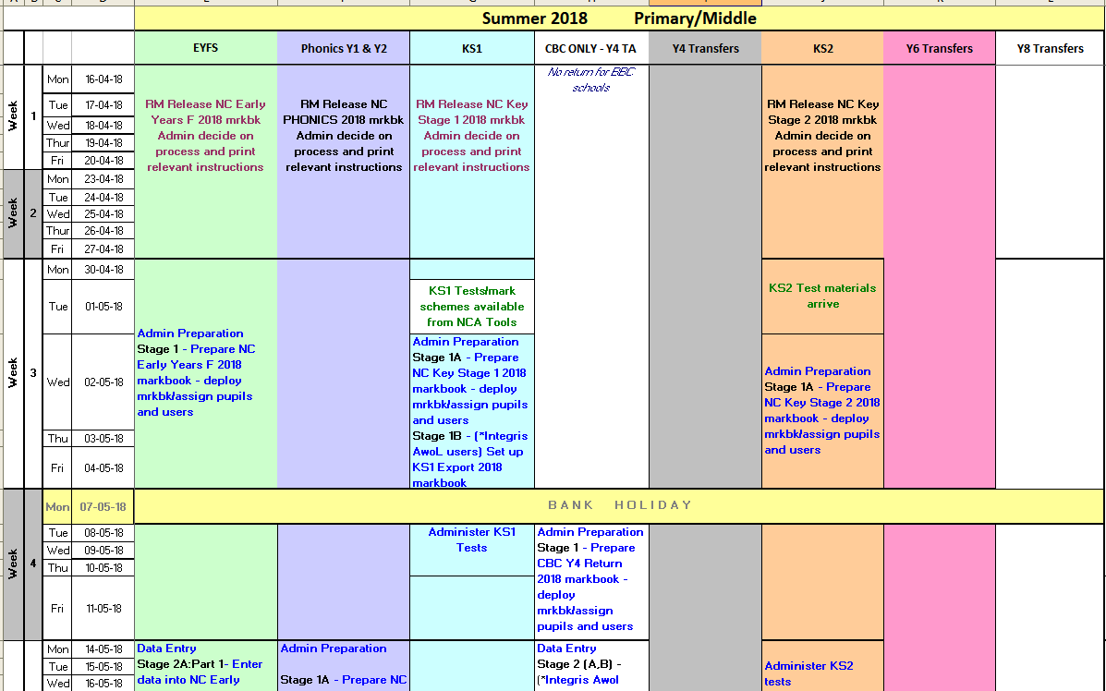
Integris User Forum
Summer 2018 Assessments – Activity Calendar

Slide 23
Integris User Forum Summer 2018 Assessments
“Official’ Integris markbooks for 2018 to enable you to make the returns:
NC Early Years Foundation 2018 – no change
NC Phonics Y1 & Y2 Re-Checks 2018 – no change BUT threshold score released 25th June 18. Enter phonics values (Wa/Wt) on/after 25/6
CBC Y4 TA Return 2018 – Age Related Expectation (1,2 or 3) & Threshold %
NC KS1 Markbook 2018 – as per 2017
NC KS2 Markbook 2018 – as per 2017

Slide 24
Integris User Forum Summer 2018 Assessments
In addition:
Y4 Transfer markbooks (collates KS1 – Y4 data and everything you have in between)
Y6 Transfer markbook (collates KS1 – Y6 data and everything in between)
Import Y5 data (for Primary/Middles)

Slide 25
Integris User Forum Summer 2018 Assessments
EYF GLD Measures 2018 – to calculate your % GLD and identify pupils who have met GLD or not
KS1 Measures 2018
Y4 Measures 2018
KS2 Measures 2018
KS2 Prog Measures 2018 (RM)

Slide 26
Integris User Forum Summer 2018 Assessments
Data Co-ordinator for assessment
Get the data right – make sure it is correct
Get the pupils right – know your starters and leavers and check whether included or not – new handout as a quick reminder!

Slide 27
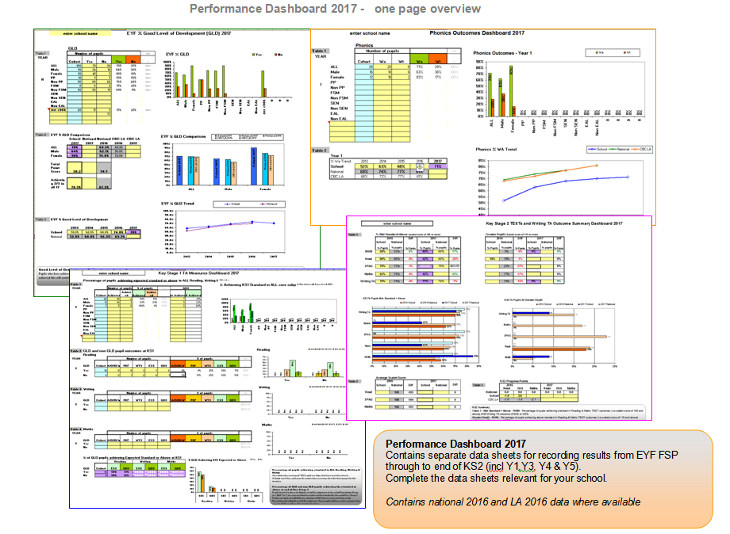
G2 User Forum Summer Assessments 2018
Performance Dashboard 2018 and (new!) Simple Dashboard

Slide 28
Integris User Forum Summer Return Data Options?
Option 1 - Integris Assessment (Objs) users and/or EYF Assessment users - enter data into your own usual markbooks
Option 2 – using external s/ware but wish to manually enter return data into Integris NC markbooks and make return from Integris
Option 3 – using external s/ware to record and make return – only import return data into Integris

Slide 29
Integris User Forum Changes to Assessments from 2019
2 public consultations: Primary Assessment & Rochford Review
KS2: No KS2 TAs for R & M except for pupils working below standard of the NC tests
Pscales 5-8 replaced by Pre Key stage standards for R,W & M
Voluntary pilot for Multiplication Tables Check (MTC) for all Year 4

Slide 30
Integris User Forum Changes to Assessments from 2019
Sept 2019 New Reception Baseline Assessment (RBA) national pilot – voluntary basis – statutory from Sept 20
June 2020 – MTC rolled out nationally for Year 4 (current Y2)
Pscales 1-4 to be replaced with an alternative scheme

Slide 31
Integris User Forum Changes to Assessments from 2019
From Sept 2020 – RBA rolled out nationally
RBA will be starting point from which progress to KS2 sats is calculated
YR at 2020 will be Y2 KS1 cohort at 2022 – at this point, expect KS1 TAs to be dropped as a statutory assessment point – 2022 last year for KS1 TAs

Slide 32
Feedback,
Quiz Winner!
Roundup
& Close

