Slide 1
RM Integris and GDPR
Dom Fox
Product Specialist

Slide 2
How can RM Integris help with GDPR compliance?

Slide 3
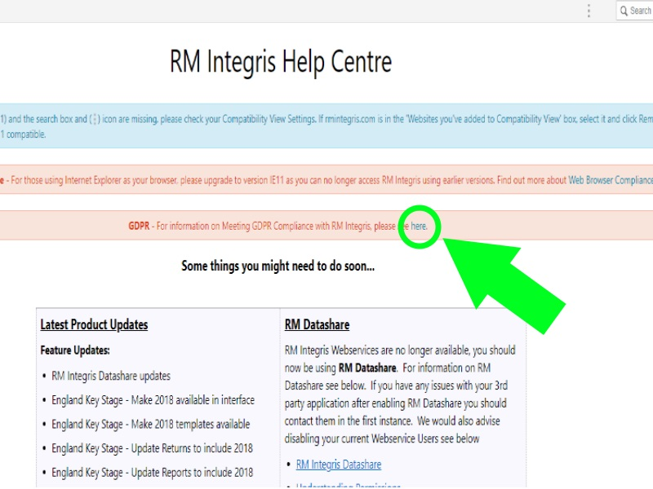
How can RM Integris help with GDPR compliance?
Information Audit
http://help.rmintegris.com/information-audit

Slide 4
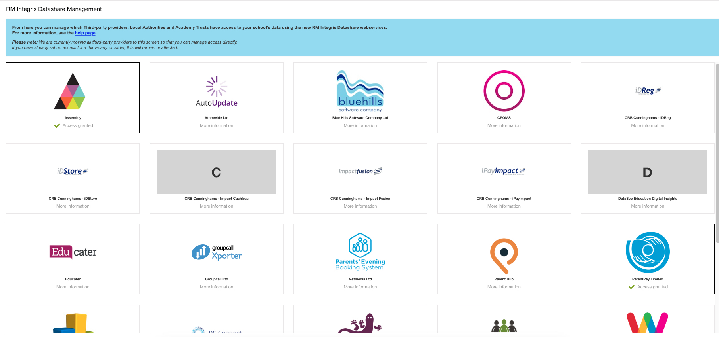
How can RM Integris help with GDPR compliance?
RM Integris Datashare

Slide 5
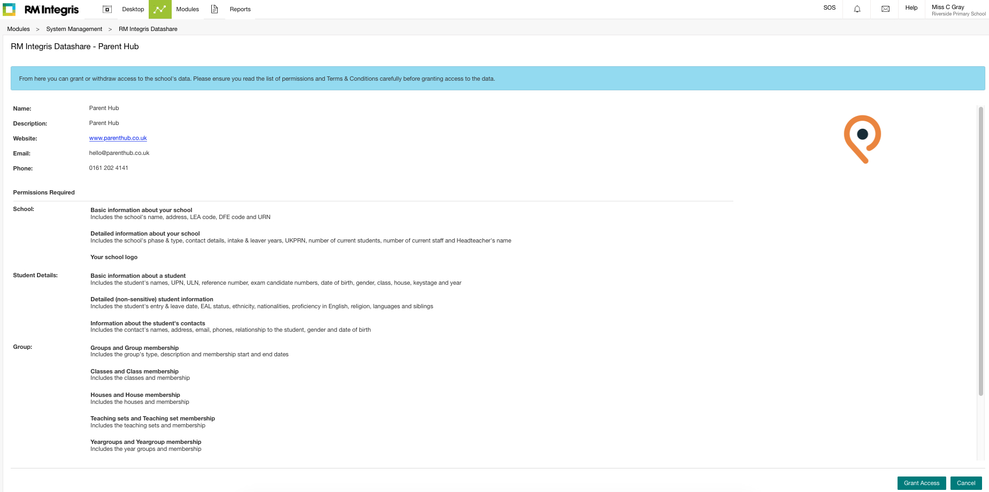
How can RM Integris help with GDPR compliance?
RM Integris Datashare

Slide 6
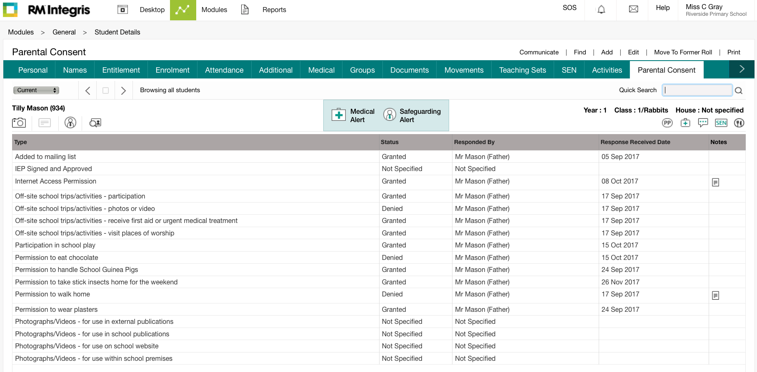
How can RM Integris help with GDPR compliance?
Parental consents

Slide 7
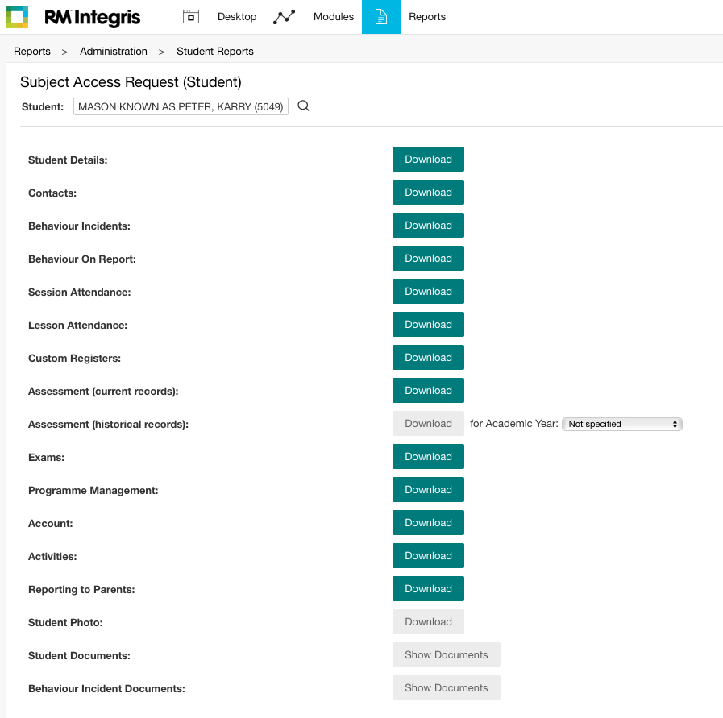
How can RM Integris help with GDPR compliance?
Subject Access Requests

Slide 8
How can RM Integris help with GDPR compliance?
Data Deletion

Slide 9
How can RM Integris help with my GDPR compliance?
For more information on meeting GDPR compliance with RM Integris please visit:
http://www.rm.com/gdpr/integris

Slide 10
Questions

Slide 11
In the last 6 months

Slide 12
In the last 6 months we’ve…
Progress update
Had 6 new releases
Fixed 44 bugs
Added 4 new features
Introduced 13 feature updates
Delivered 6 Statutory Updates
Notes:
Just looking back over the last six months, we’ve…
Had 6 new releases. Don’t forget to check out the release notes (click on the pop-up) to see what’s new.
Fixed 44 bugs. These are support requests that need to be fixed. So if you call the support team, we record it and will fix the problem as soon as possible. We know it’s not perfect, but we need your help to tell us what doesn’t work so we can fix it
Added 4 new features. We’ve added Behaviour Incident UDIs, Custom Registers, Subject Access Requests and Data Deletion
Introduced 13 feature updates. We’ll be showing you some of them today. Please continue to use User Voice. Click on the logo in Integris and then Integris User Voice. You can suggest a new idea and vote on others’ suggestions. We use this to help us develop our roadmap, so we do listen to your suggestions.
Delivered 6 Statutory Updates. We do all the hard work for you. We keep up to date with statutory changes so you can feel assured the data in your MIS is compliant

Slide 13
What’s New?

Slide 14
What’s new?
Overview of progress
Custom Registers
Behaviour Changes
SEN code changes
RM Integris Datashare
Parental Consent reports
Audit Log
Subject Access Request reports
Data Deletion
Notes:
Here are some of the highlights from the new features we’ve added recently. Many of these are related to our GDPR work, so we’ll look at them in the GDPR section.
If you’re thinking, ‘why didn’t I know about these things?’, we would recommend having a quick scan of the release notes that we publish on the website and give a link in the pop up messages.
Did you know? You can go back to any of the pop-ups by clicking on the envelope. Then click on the link.

Slide 15
What’s Next?

Slide 16
Roadmap 2017-18
Qtr 2 2018
Qtr 3 2018
Qtr 4 2018
Qtr 1+ 2019
Controller enhancements
Reporting to Parents
Roles
Safeguarding
UDI Tab Names & Emergency Sheet
Assessment Analysis
Alerts
Writeback
Reporting to Parents
Ad hoc reporting
Exporting Data
Customer requests and bug fixes
Statutory Updates
Please note: the roadmap is subject to change, dependent on statutory requirements and customer requests.
Notes:
All of these items are in addition to the statutory updates we need to do on an ongoing basis, as guided by the DfE.
Please remember to use User Voice for adding your suggestions.

