Slide 2
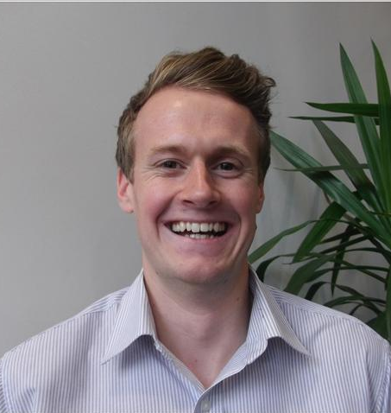
Dom Fox MIS Product Specialist
Notes:
Do a brief intro to who RM are and what we are exhibiting today

Slide 3
What’s On Today
CBICT Forum

Slide 4
What’s on Today?
An Introduction to “What’s New” with Integris
Talk through things that are coming soon
Places to gain more information
CBICT Forum

Slide 5
What’s New
CBICT Forum

Slide 6
What’s New
Last 6 months
Dinner money management
Label printing
Staff document storage
Parental consent
Photos on reports
Parental Communications
CBICT Forum

Slide 7
Parental Communications
CBICT Forum

Slide 8
CBICT Forum

Slide 9
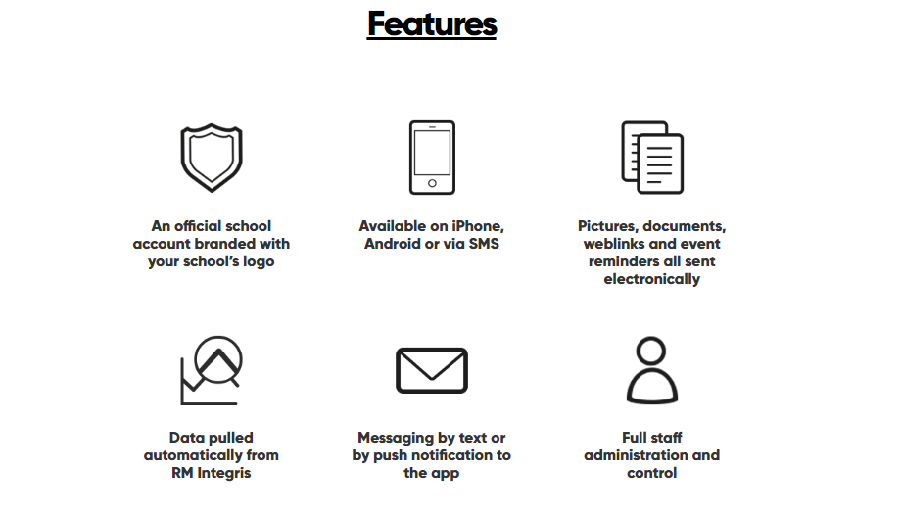
CBICT Forum

Slide 10
Parental Comms
Parental Communications
Instantly send your school’s newsletter home to parents – and check who's opened it
Link channels to your school’s Twitter feed - so that when you post a tweet, it automatically notifies parents
Take pictures of great work and send it to parents so they can celebrate their children’s achievements
Start individual conversations with groups of parents about their children’s progress and learning
CBICT Forum

Slide 11
Parental Comms
Parental Communications
Register your interest at:
http://www.rm.com/products/rm-integris/parent-hub
CBICT Forum

Slide 12
Roadmap
CBICT Forum

Slide 13
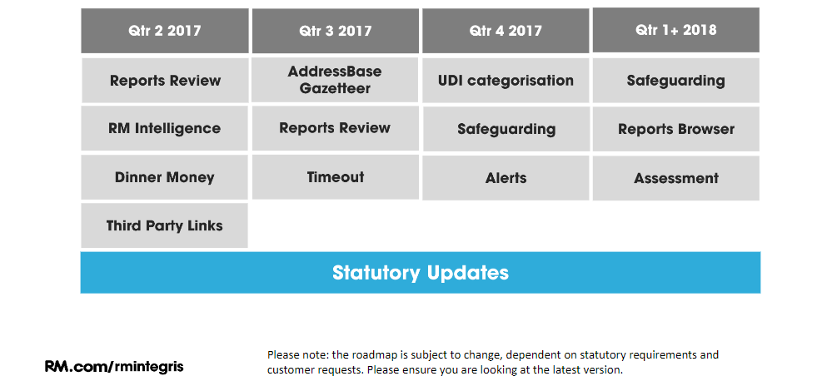
Roadmap
CBICT Forum

Slide 14
RM Insights Hub
CBICT Forum

Slide 15
RM Insights Hub
What is the RM Insights Hub?
Data Warehouse
Dashboard-style UI to show trends and top level data
Ability to hook in reporting and query tools
Takes into account bespoke Trust settings
Completing Phase 1 development
Early adoption from November 2016
CBICT Forum

Slide 16
RM Insights Hub
CBICT Forum

Slide 17
RM Insights Hub
CBICT Forum

Slide 18
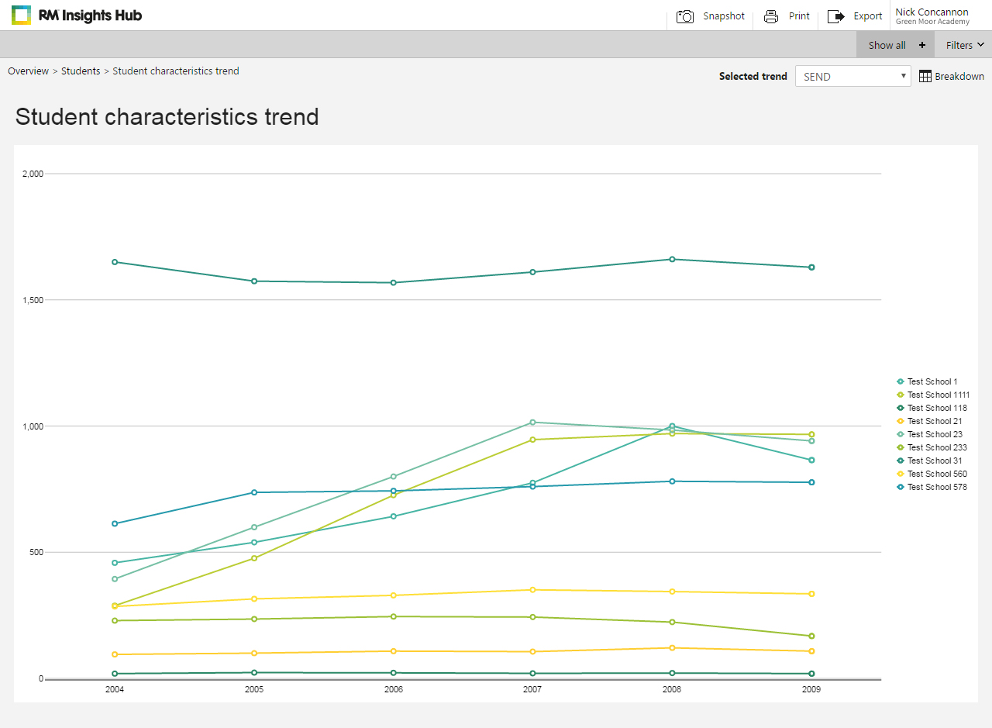
RM Insights Hub
CBICT Forum

Slide 19
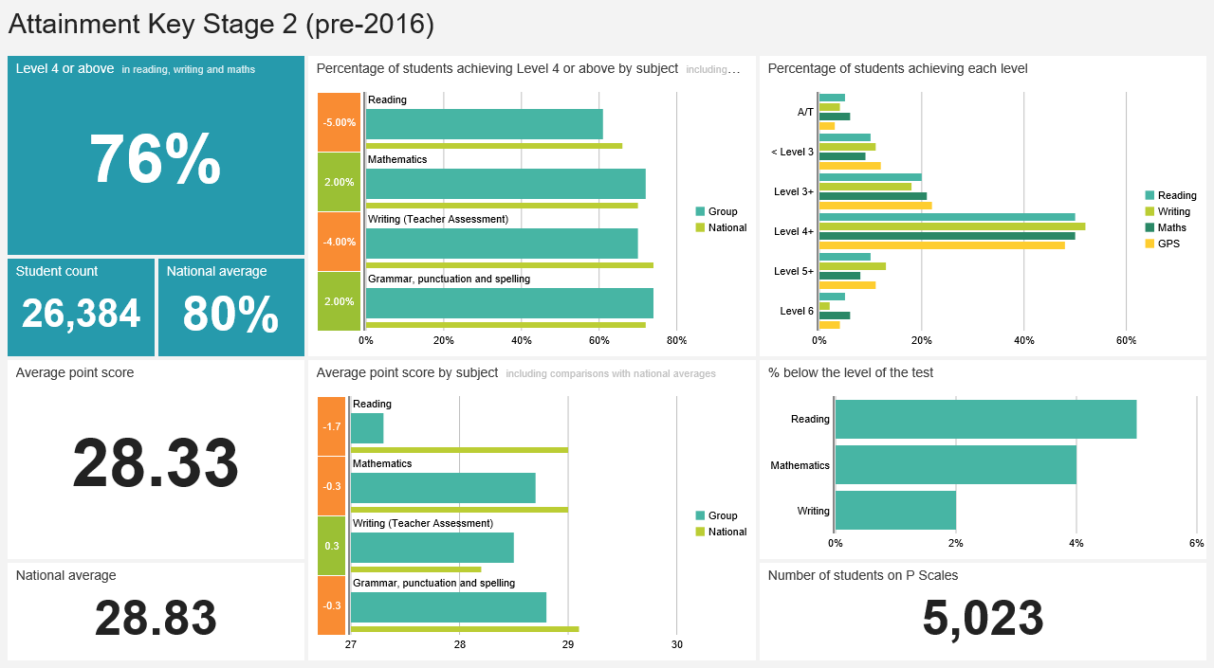
RM Insights Hub
KS2 Attainment – Pre 2016
CBICT Forum

Slide 20
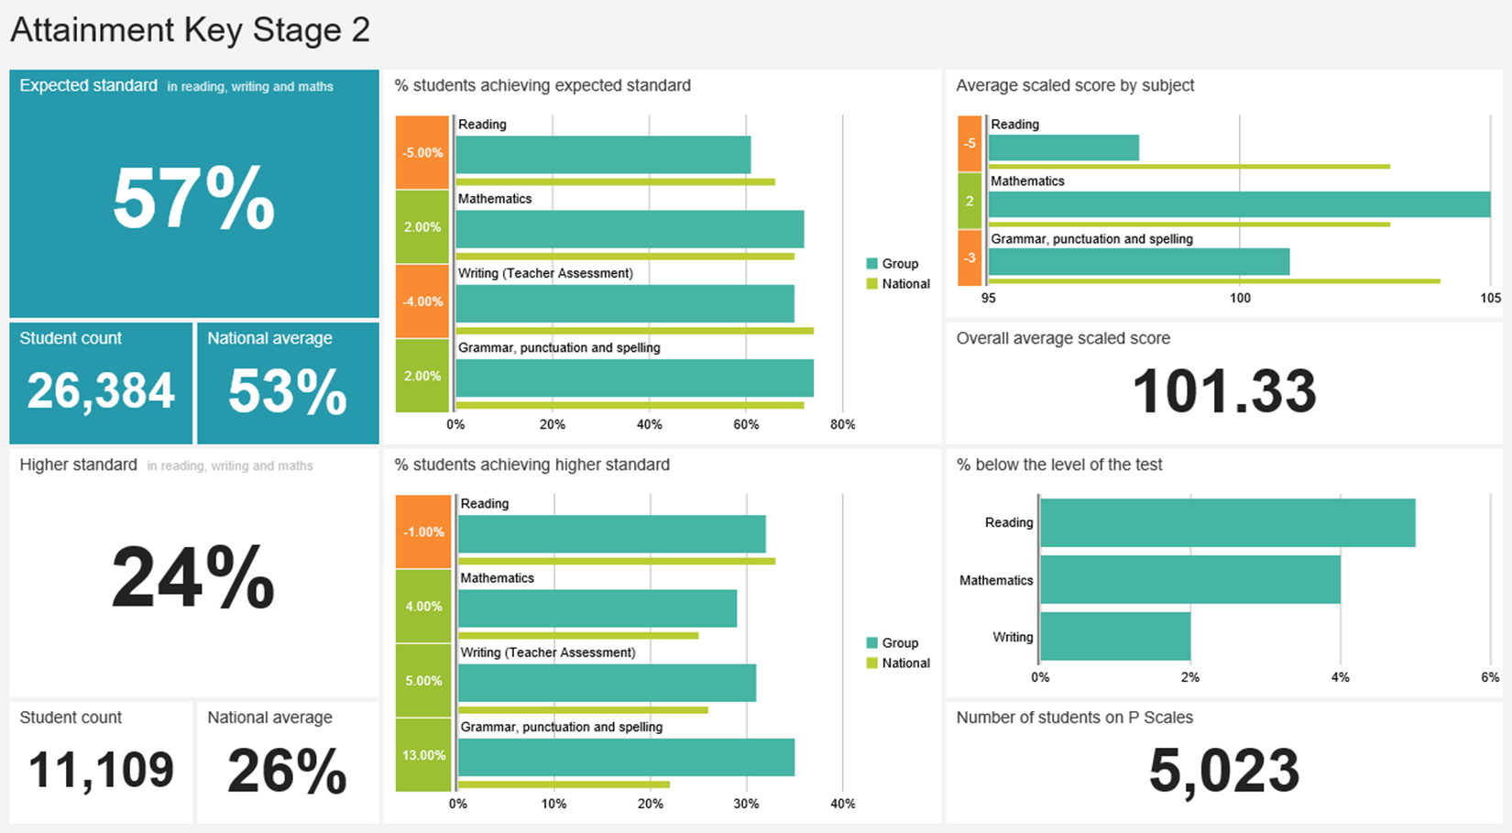
KS2 Attainment – Post 2016
RM Insights Hub
CBICT Forum

Slide 21
A Few More Things
CBICT Forum

Slide 22
A few more things…
Newsletter
Subscribe to our future newsletters
Don’t forget to sign up to our monthly newsletter…
Subscribe
CBICT Forum

Slide 23
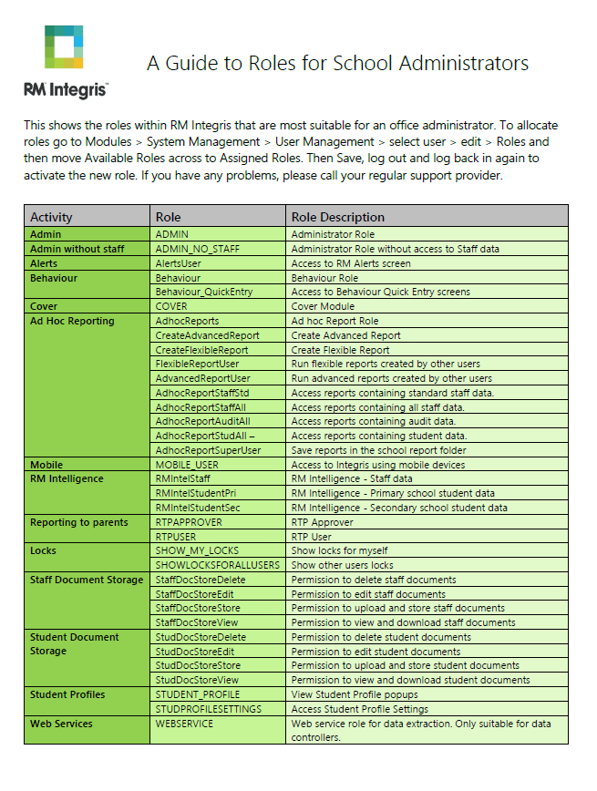
A few more things…
Download your guide to user roles
Download Roles
CBICT Forum

Slide 24
Dom Fox
RM Integris Product Specialist
dfox@rm.com
07767 417456

