Slide 1
Integris User Forum 2019
Welcome
Review…….Anticipate……..Prepare

Slide 2
AGENDA
9.15 - 9.25am Welcome, outline of morning and introducing this year’s User Quiz! 9.25 – 9.35am CBICT Support Update – a roundup of our support service
9.35- 9.50am Census news Preparing for School and SWF Census 19/20 – a heads-up on changes and related data matters 9.50 – 10.10am Assessment and the new Quick Analysis graphs – overview of processes and getting ready for this term's returns – a brief look at Quick Analysis to see attainment data for whole cohort and groups at a click of a button! – National changes to statutory assessment (MTC, EYFS Baseline, KS1-KS2 Progress) 10.10 – 10.45am GDPR focus – a year on…… – latest information from the ICO – A HT’s perspective on the compliance journey with Julie Ashwell (HT at Raynsford Lower)
10.45 – 11.00am Coffee break and networking
11.00 – 12.45 Integris focus with Mark House (RM) Road Map – an update on what’s new now and just around the corner Training Academy – are you ready to help shape this new feature? Parent Hub – latest developments Integrating Integris with office 365/G Suite – making the hard things easy… 12.45 – 1.00pm Feedback, Roundup & Close

Slide 3
CBICT Support
Enhanced support (Sep – Aug): Essentials/SWF/Summer Assessment will continue into 2019/20 – flyer will go out after half-term
Ist Line Helpdesk (Apr-Mar): cbict999@gmail.com/admin@cbict.org.uk Phone: 07484 639404
Website: www.cbict.org.uk (LiteBites and more..)
Newsletters via email
Annual User Forum
RM User Voice – www.integris.uservoice.com
RM Newsletter – https://integris.uservoice.com/forums/157700-integris-forum
GDPR Support and advisory visits and/or Audit
Bespoke training
LET US KNOW ANY CHANGES TO EMAIL ADDRESSES. ARE YOU ON OUR MAILING LIST?

Slide 4
Census 2019/2020 Reference dates
School Census
Autumn – Thu 3rd October 2019
Spring – Thu 16th January 2020
Summer – Thu 21st May 2020
SWF Census
Thu 7th November 2019 (deadline for submission 6th Dec 2019)
(Pupil Premium Download for 2019/20 financial year due in July)

Slide 5
School Census 2019/20
New data item
Class Activity (Jan): For Lower/Primary schools - only where a key stage 1 and / or a reception class reports 31 or more pupils per teacher the schools must record where this is due to: • a teacher being on PPA or Learning Manager Time (LMT) and the class is being supervised by a teaching assistant
Exclusions Exclusions data collected for one term in arrears (brought in line with Attendance)
Removal of the Lunchtime – ‘LNCH’ category for exclusions from autumn 2019.
New data items
Exclusion review date
Exclusion review result
Exclusion reinstatement date
Exclusion review SEN expert for independent panels only - whether a SEN expert was requested
Notes:
To note: the exclusion start date and exclusion reason are collected for both permanent and fixed period exclusions,. For fixed period exclusions, the actual number of sessions are also collected

Slide 6
School Census 2019/20
For permanent exclusions ONLY during the 2019 / 20 academic year, exclusion reviews (governor) and independent review panels (IRP) are to be reported from the spring (Jan) 2020 census. Where both governor review and IRP taken place – only the final outcome is to be recorded (as per code list).
The exclusion review date and exclusion reinstatement date (where applicable) should also be recorded
Additionally for IRP only - schools must also record if an SEN expert was requested during the review. This should be recorded as ‘Y’ if requested and ‘N’ if not requested.
No information re review panels is collected for fixed term exclusions
Notes:
Exclusions that have been overturned by the governing body are not counted in national statistics
Schools must therefore ensure that final exclusion result and the outcome of the exclusion reviews, including whether an SEN expert was requested are maintained on an event driven basis so that the final outcome of review results can be recorded.

Slide 7
School Census 2019/20
Exclusion Reviews – Final outcomes
A | Exclusion upheld by initial governor review (confirmed)
B | Exclusion upheld by governing body after independent review panel recommended governing board to reconsider reinstatement
C | Exclusion upheld by governing body after independent review panel directed governing board to reconsider reinstatement
D | Exclusion upheld by independent review panel (confirmed)
E | Pupil accepted reinstatement after initial governor review
F | Pupil accepted offer of reinstatement after independent review panel recommended governing board to reconsider reinstatement
G | Pupil accepted offer of reinstatement after independent review panel directed governing board to reconsider reinstatement
H | Pupil declined reinstatement after initial governor review

Slide 8
SWF Census changes 2019
'Graduate Teacher Programme' has been removed from the codeset for QTS Route
A new post of 'Apprentice Teacher' which will have all the same data requirements of existing teacher posts,
New POSTS of 'Leadership - Non Teacher' (Code 'LNT') and 'Other Support Staff' (Code 'OSP') have been added and the older post of 'Support Staff' has been removed. Note: qualification data for teachers, teaching assistants and for non-teaching school leaders required but no longer required for other support staff. All qualifications graded at level 4 or above (i.e. post A-level qualifications) should be included.

Slide 9
Assessment – this summer
Summer Assessment Package covers:
Quick roundup: EYFS return Phonics – ALL Year 1 and Y2 Re-checks KS1 – all Year 2 Year 4 (CBC schools) KS2 – all Year 6 Performance Measures markbooks for EYF, KS1, Y4 & KS2 All instructions on www.cbict.org.uk – having all your statutory data on Integris will enable to build a key stage picture of each pupil in their record – benefit from the various reports and analysis
ALLOW TIME TO QUALITY CHECK – you can run to the reporting stages to see what your data means for the school i.e. % figures before you create the return – work to the Activity Calendar

Slide 10
Assessment
KS1 TA Framework - standards for pupils working at the age related expectations and pre key stage standards – teachers base their judgments against the ‘pupil can’ statements
KS2 Framework for TA – Writing & Science Only from this year. Standards for pupils working at the age related expectations and pre key stage – teachers base their judgments against the ‘pupil can’ statements. Very likely that schools will want to continue recording TAs for Reading & Maths
Reception Baseline Assessment (RBA) – new for Sept 2020 – pilot year 2019/20 The assessment is an age-appropriate, activity-based assessment of a pupil’s attainment in early literacy, communication and language and early mathematics skills. https://www.gov.uk/government/publications/reception-baseline-assessment-framework NFER pilot details: https://www.nfer.ac.uk/for-schools/participate-in-research/information-about-the-201920-reception-baseline-assessment-pilot/
Maths Timetable Check (MTC) for Year 4 mandatory from summer 2020 – pilot window from 10th – 28th June 2019– access via NCA Tools (super-users can give access to other users in school) https://www.gov.uk/guidance/multiplication-tables-check-development-process

Slide 11
Assessment – looking to the future
YR EYF Baseline ---[EYF FSP]-------Y1 PHO----Y2 PHO recheck----[Y2 KS1TA]-------Y4 MTC--------Y6 SATS
Aut 2020 Sum 2020
Progress from KS1 (Levels) to Year 6 - using APS (Levels) to Average Scale Score for last time - next year will be using the age related expectations (PK; WTS;EXS & GDS) average
Progress not calculated ONLY if KS1 data not available!
From 2026 progress will be calculated from Reception Baseline result
From Sept 2022, likely that no KS1 TA returns

Slide 12
Integris –new QUICK ANALYSIS
New QUICK ANALYSIS in Integris Modules > Assessment > Analysis > Quick Analysis > find your assessment plan (markbook) Can graph any DATA ENTRY column in any markbook for the whole cohort (Year/class) and for individual standard groups within that cohort If you are using Integris Assessment objectives or have bought into the Summer Assessment package, any of the data entry columns in any markbooks you are using can be analysed in this way.
Any markbook where:
EYF – any Area of Learning/ELGs where 1,2 or 3 have been entered
PHOnics Outcome column - Wa/Wt
KS1 TA - columns where PK1-4/WTS/EXS/GDS entered
Y4 TA – columns where Y4 TA 1,2 & 3 values entered
KS2 TA – columns where PK1-6/WTS/EXS/GDS entered
Notes:
Summer Package users – for each data collection – QUICK ANALYSIS is a new stage and instructions available for each data set
Based on data entry columns – so any column where it shows something as a result of a calculation – you can’t graph it (e.g Is pupil GLD? Y/N values CAN”T be graphed)
If an assessment user already, then can graph all the objectives markbooks – e.g. individual objects

Slide 13
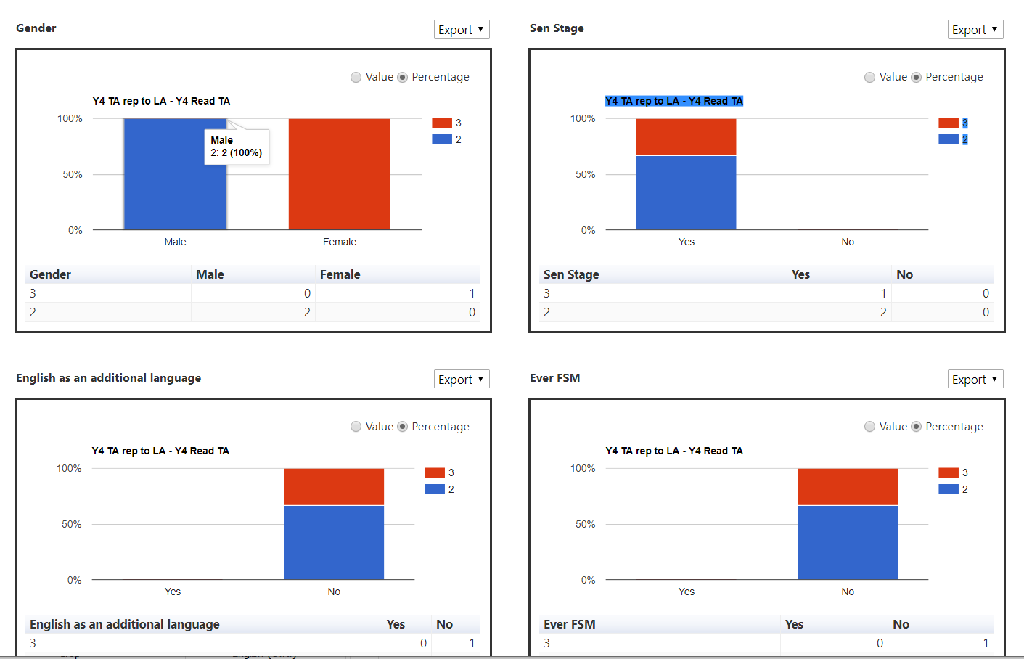
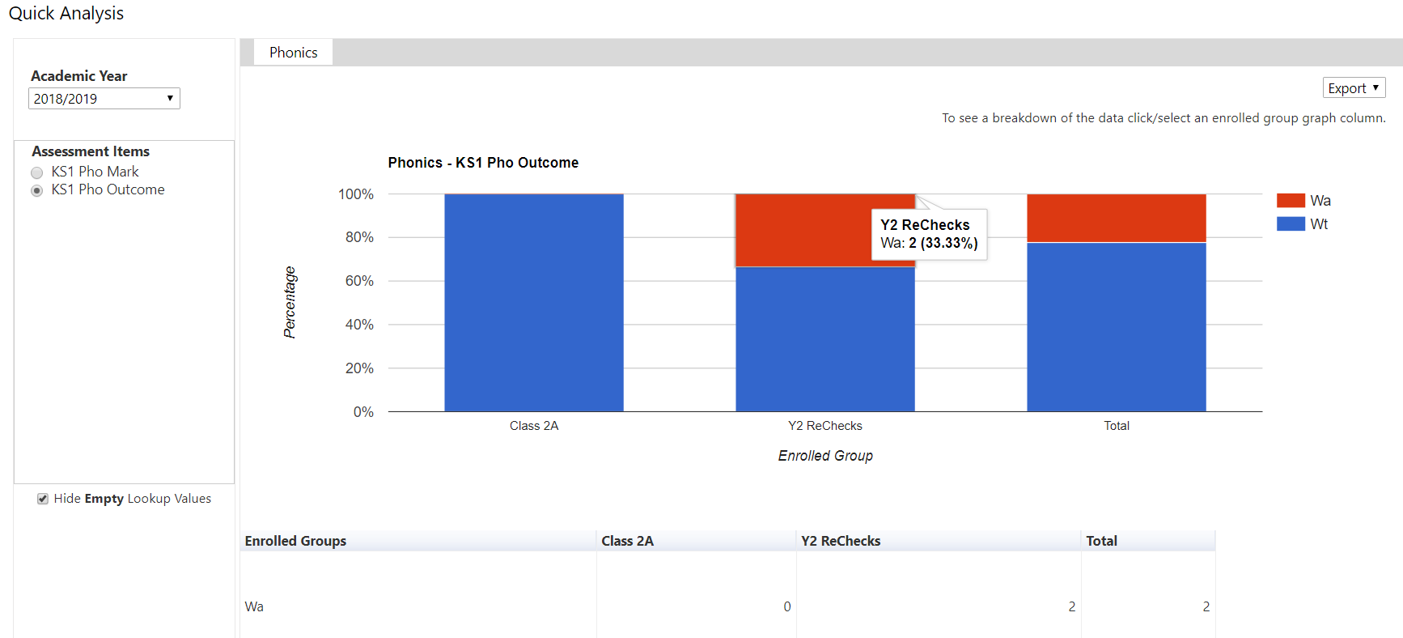
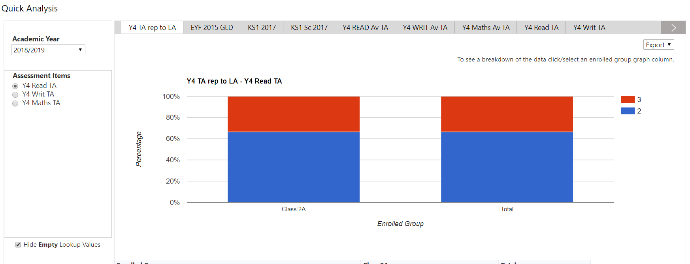
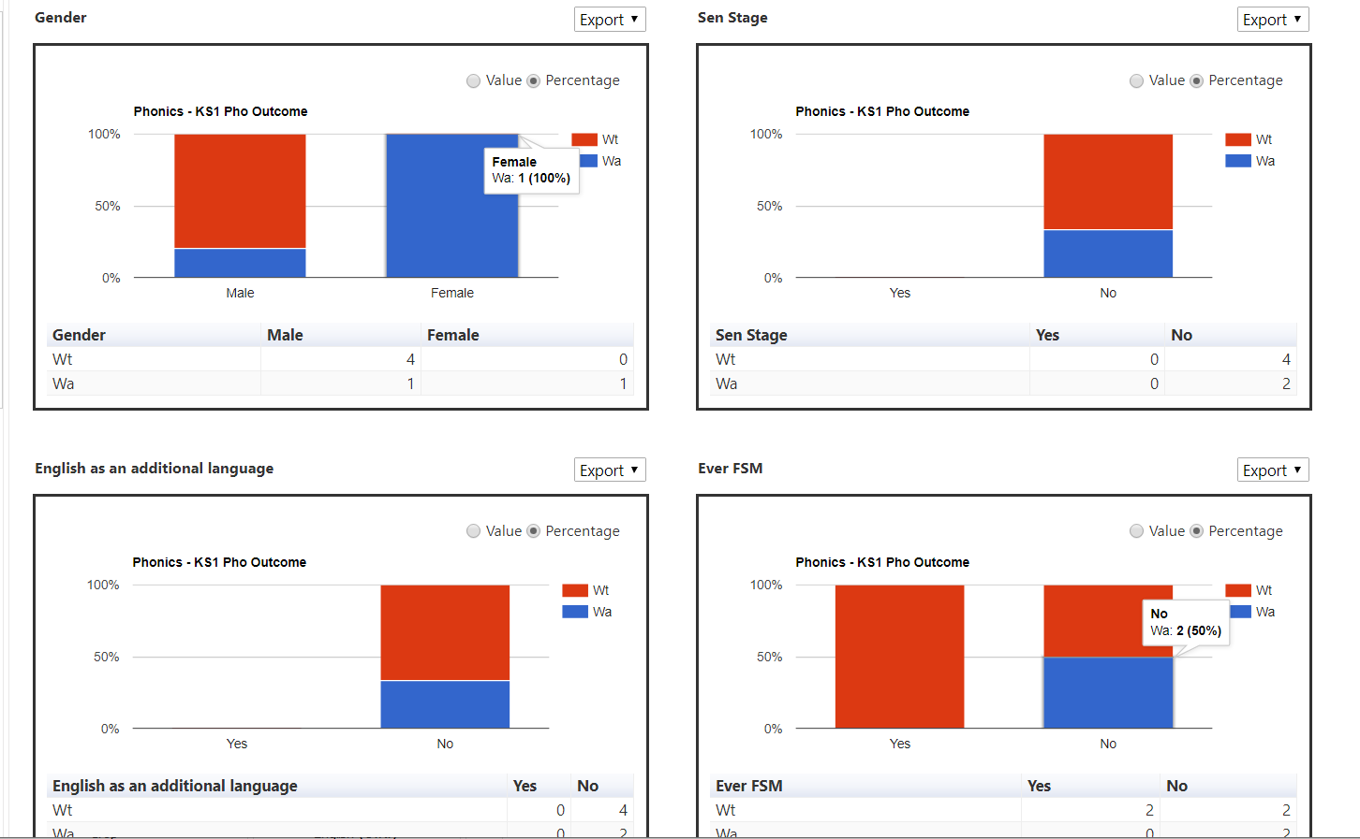
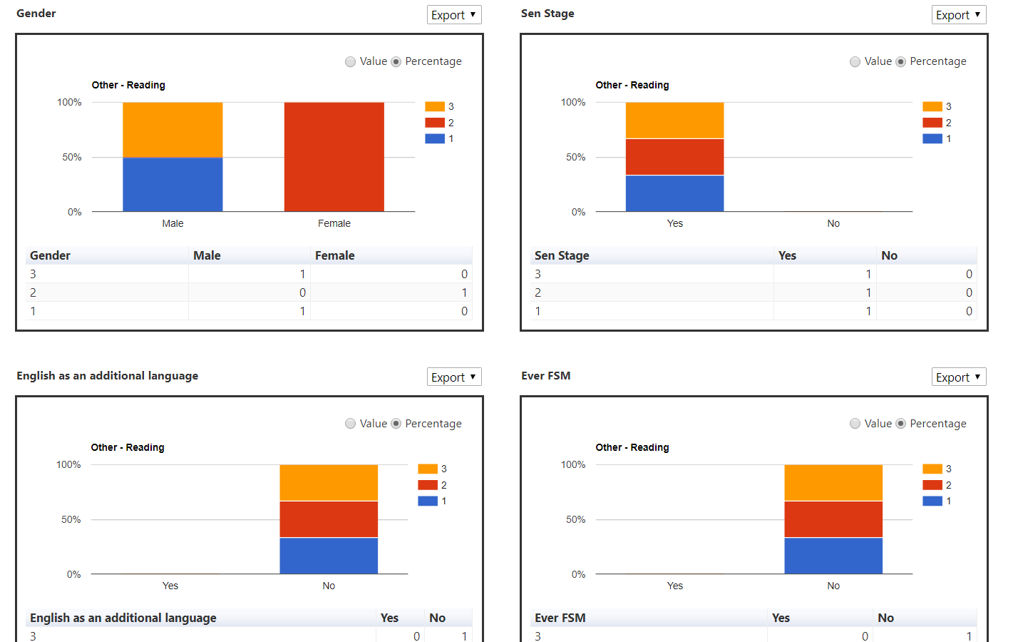
Notes:
Take care about what you are selecting to graph!
Groups are standard groups – Gender; SEN; EAL; Ever FSM (PP FSM pupils)
PP ANY EVER – includes Post Looked After; Service Children; or CLA
Each graph has a table under it showing pupil numbers!!!! Useful if you are completing the Performance Dashboard!

Slide 14
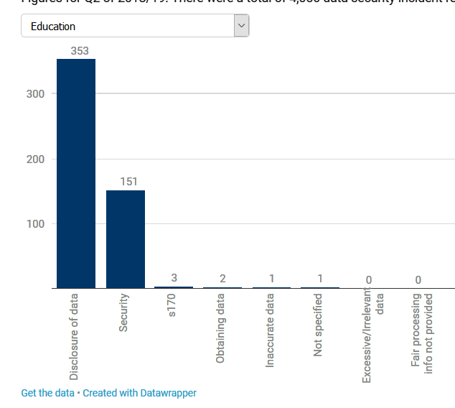
GDPR update
Age Appropriate Design – a code of practice for online services – Consultation Document (closes 31st May) asking for your views on standards for online services to help protect children – practical guidance on 16 standards of age appropriate design for information online services accessed by children. https://ico.org.uk/media/about-the-ico/consultations/2614762/age-appropriate-design-code-for-public-consultation.pdf
Data Breaches Reported to ICO
End of Q2 of 2018/19 – total of 504 incidents reported across Education sector mainly Disclosure of Data (353 incidents) followed by Security (151)
To note:
Independent Inquiry into Child Sexual Abuse (IICSA) £200K fine
Emma’s Diary - £140K fine

Slide 15
GDPR update
For GDPR Subscriber schools – you have available:
Subject Access Request Policy and Procedures (template) & SAR Form
Data Breach Management Policy (template) and DB Report Form
Staff Acceptable Use Policy (AUP) Agreement template
Good practice with passwords
Reminder:
RMIntelligence – Audit screen provides information about logins/password failures
CBICT offer advisory visits, Audits and helpdesk questions/advice.
DfE GDPR Toolkit – updated Sept 2018 (link on GDPR News page on www.cbict.org.uk)
ICO announced will be updating their guidance on school related matters

Slide 16
Welcome to Julie Ashwell (HT at Raynsford Lower)
A HT’s perspective on compliance with GDPR and the school’s journey thus far……
followed by
Coffee break

Slide 17
Integris Focus with Mark House (RM)

Slide 18
Roundup, Questions & Close

